Slide 1
Student Data Analyst
By Christopher Douglas

Slide 2

Research Question
Regression Question: How do Hours_Studied, and Sleep_Hours predict a student's exam score?
Classification Question: Can we classify whether a student scores above average based on study habits and socioeconomic factors?

Slide 3
Dataset Overview
6,607 student records
Numerical: Hours_Studied, Sleep_Hours, Attendance, Tutoring_Sessions
Categorical: Gender, Parental_Education_Level, Motivation_Level, etc…
Key Attributes
Exam_Score
Hours_Studied
Above_Average_Score
Attendance
Mean Exam Score

Slide 4





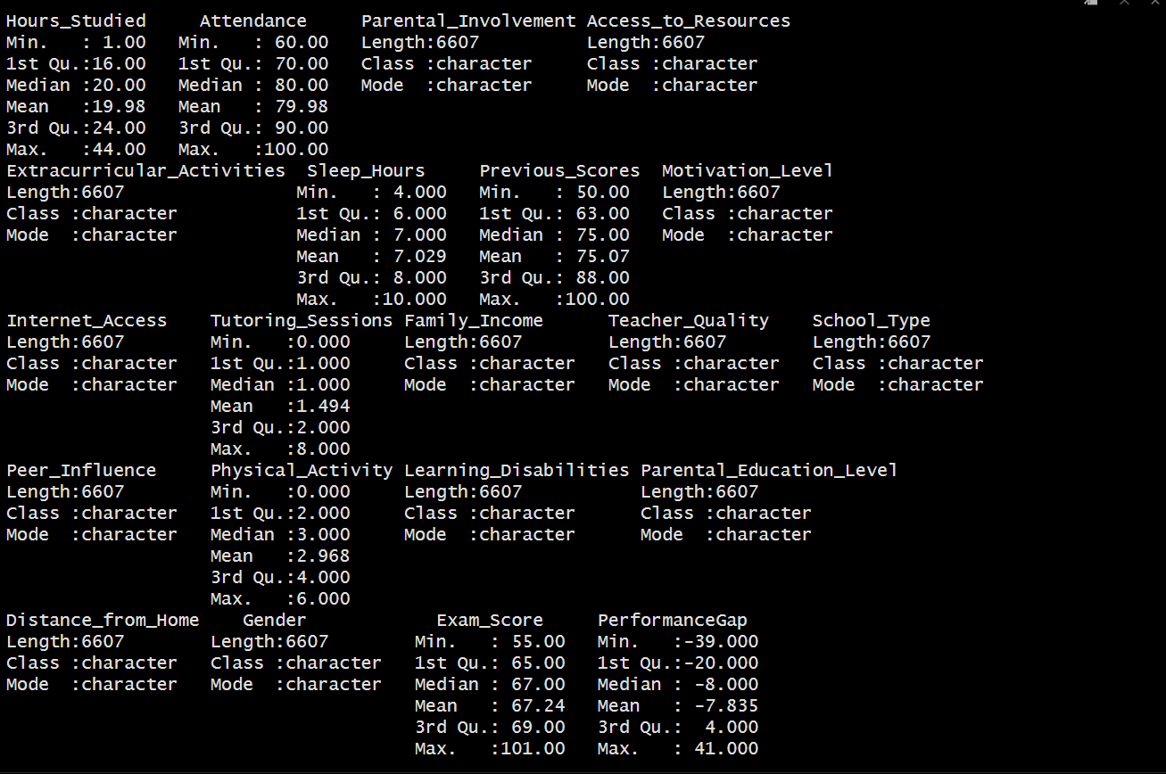
Exploratory Data Analysis
Exam mean = 67
Max = 100
Min = 60
Pervious score mean = 75
Max = 100
Min = 50

Slide 5
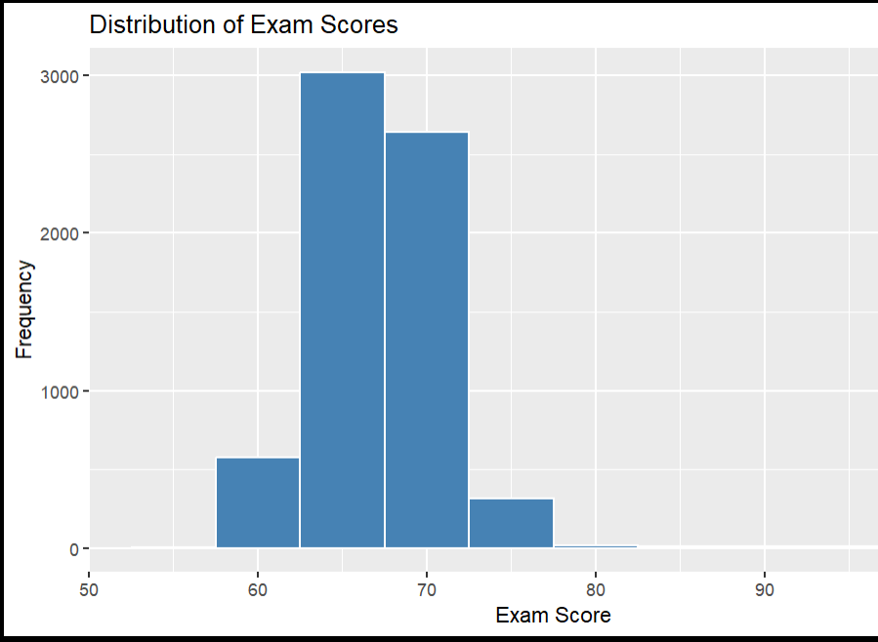
Distribution of Exam Scores

Slide 6
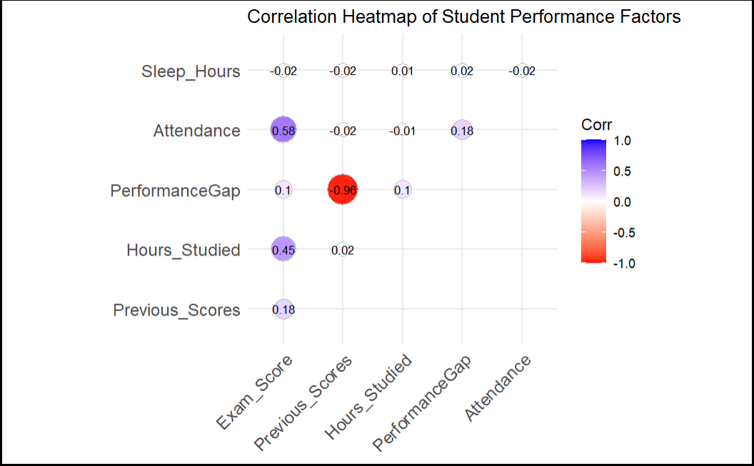
Correlation Heatmap

Slide 7
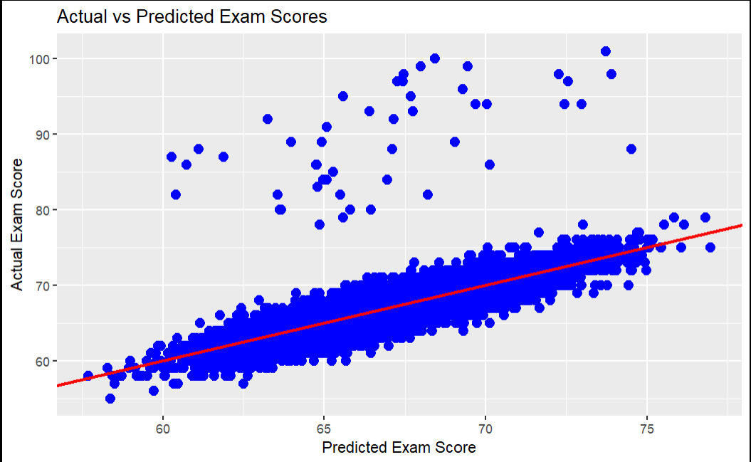
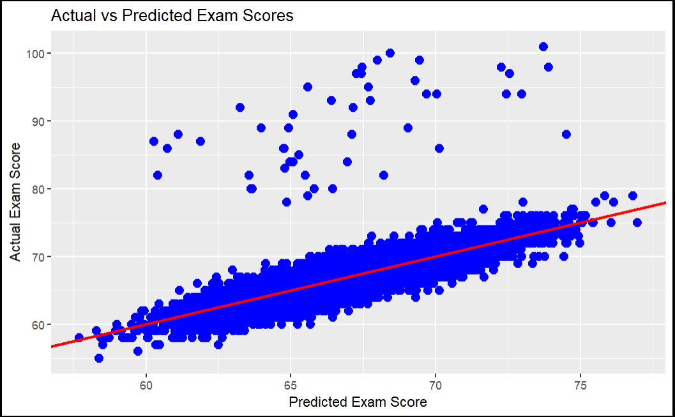
Linear Regression
Exam_Score ~ Previous_Scores + Hours_Studied + Attendance + Sleep_Hours
R-squared: 0.572, p-value: < 2.2e-16
Exam_Score ~ Sleep_Hours + Hours_Studied
R-squared: 0.1987, p-value: < 2.2e-16

Slide 8
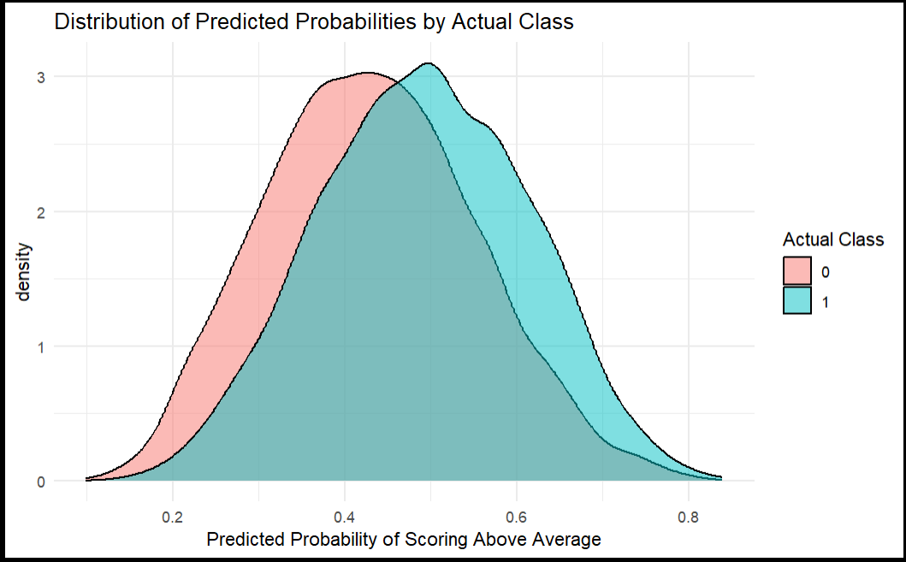
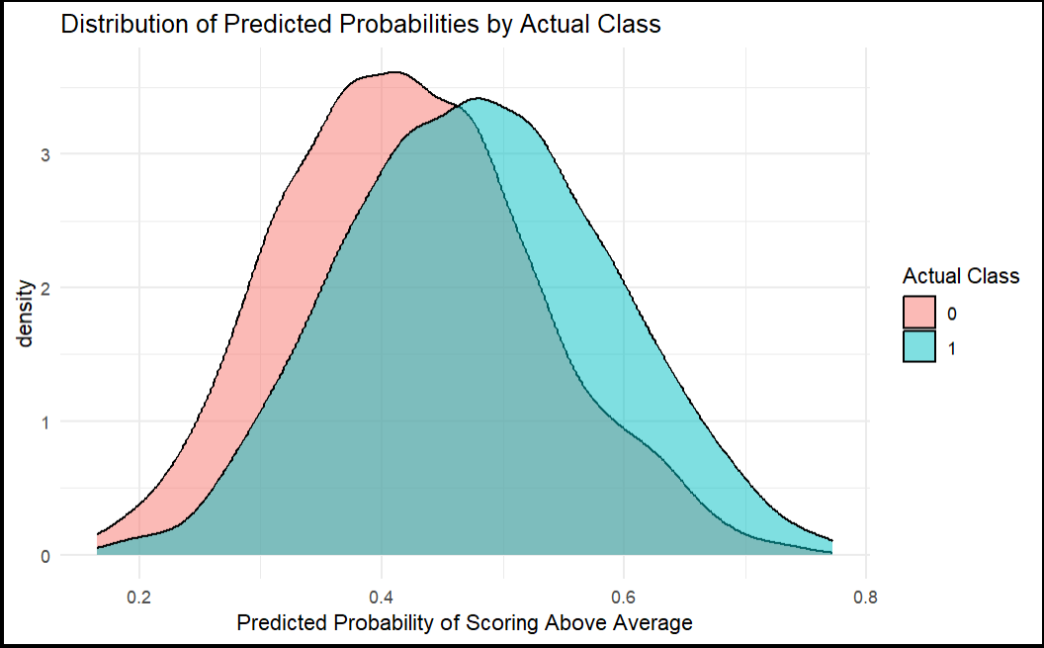
Classification
(AboveAverage ~ Parental_Involvement + Extracurricular_Activities + Motivation_Level + Internet_Access + Family_Income and etc…
62% Accuracy
AboveAverage ~ Parental_Involvement + Motivation_Level + Family_Income + Extracurricular_Activities + Peer_Influence + Parental_Education_Level + Teacher_Quality
61% Accuracy

Slide 9
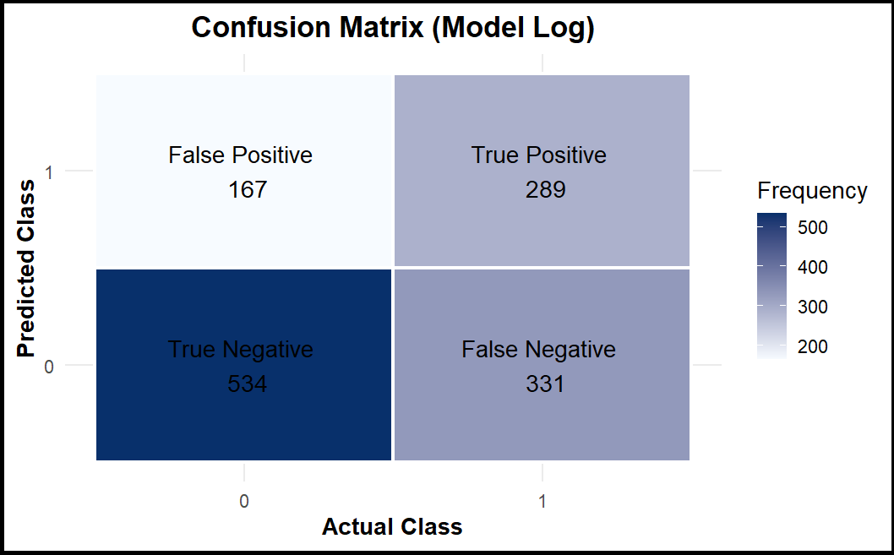

Logistic regression Regression
Residual deviance: 6910.3
AIC 6952.3
Residual deviance: 7011.3
AIC 7043.3

Slide 10
Conclusion
Numerical Factors played a large role
Categorical data was difficult to model
One social or economic factor does not dominate exam scores

Slide 11
Thank You

